Slide 1
1st Virtual IMT-GT Varsity Carnival 2021
(Registration Guide for University Official)

Slide 2
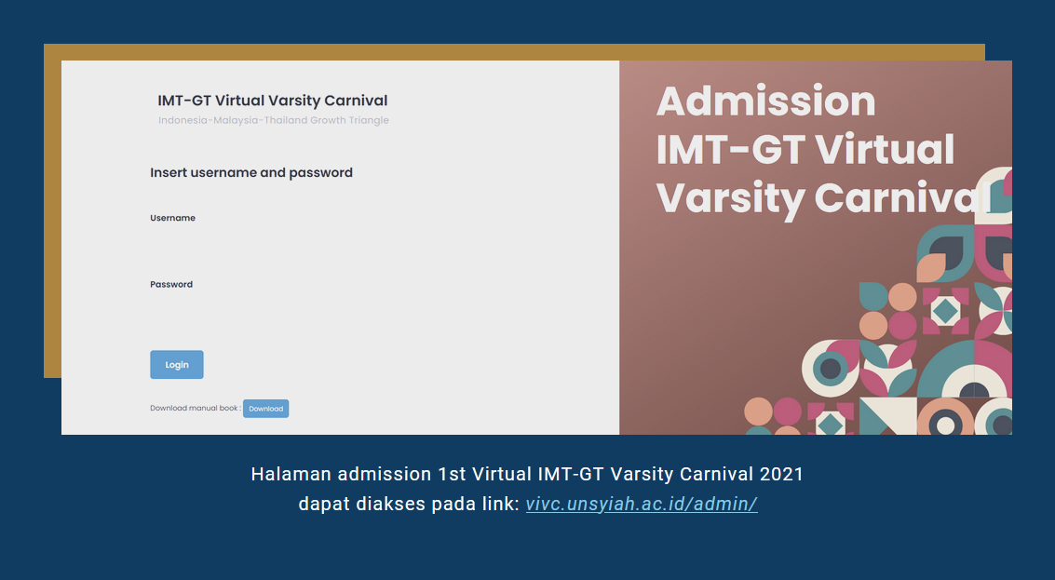
Admission page for 1st Virtual IMT-GT Varsity Carnival 2021
can be accessed on this link : vivc.unsyiah.ac.id/admin/
Accounts for logging in have been assigned to Official of each Universities.

Slide 3
Official of the University will get 2 soft card (look this card), each:
For Sport Category
For Cultural Category
Guide Registration:
Official login
Official do registration for the students or officials
Official submit the video submission for each categories
*for the detail, see next slide*

Slide 4
SPORT CATEGORY

Slide 5
Sport Registration
Table of participants list
Adding button for adding students and official datas
(e-sertificate)
If adding process is success, a notification like this will come out:

Slide 6
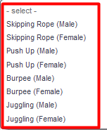
Sport Registration Form

Slide 7
Sport Submission
preview button
for previewing uploaded video
delete button for deleting list
adding button
for adding video
If adding process is success, a notification like this will come out:

Slide 8
Video upload field

Slide 9
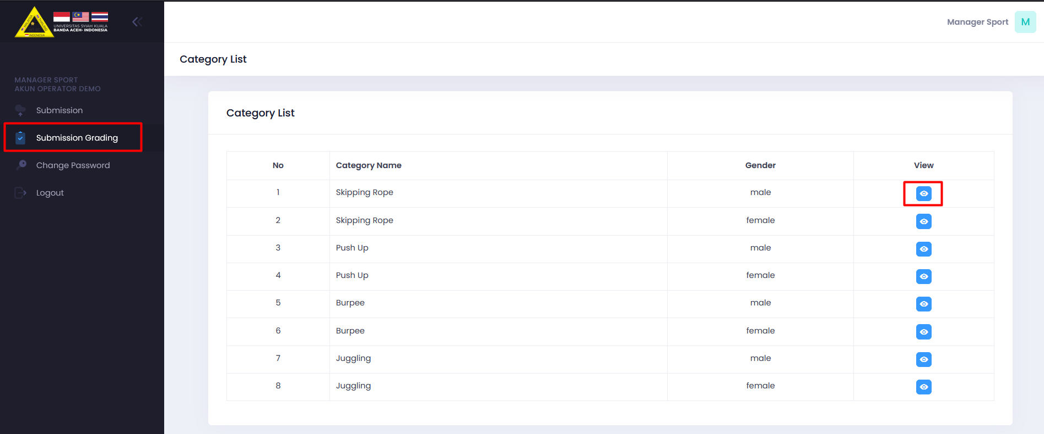
Sport Submission Grading
preview button
for viewing grading

Slide 10
Page submission grading for skipping rope and another sport category could be seen in this page

Slide 11
CULTURAL CATEGORY

Slide 12
Cultural Registration
Table of participants list
Adding button for adding students and official datas
(e-sertificate)
If adding process is success, a notification like this will come out:

Slide 13
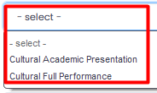
Cultural Registration Form

Slide 14
Culture Submission
preview button
for previewing uploaded video
delete button for deleting list
adding button
for adding video
If adding process is success, a notification like this will come out:

Slide 15
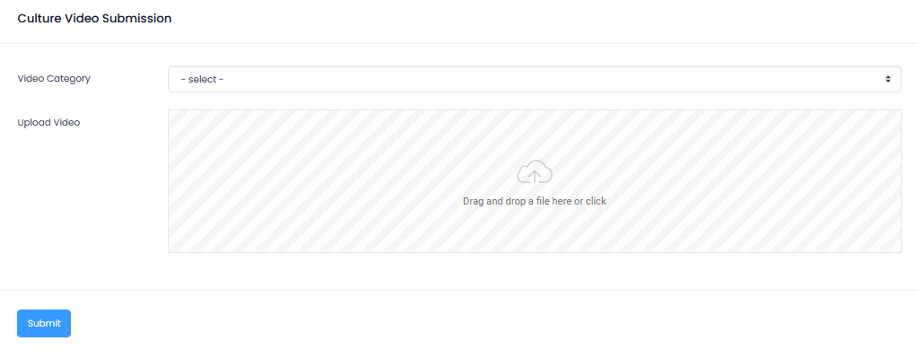
Video upload field

Slide 16
Cultural Submission Voting
Klik for voting the category

Slide 17
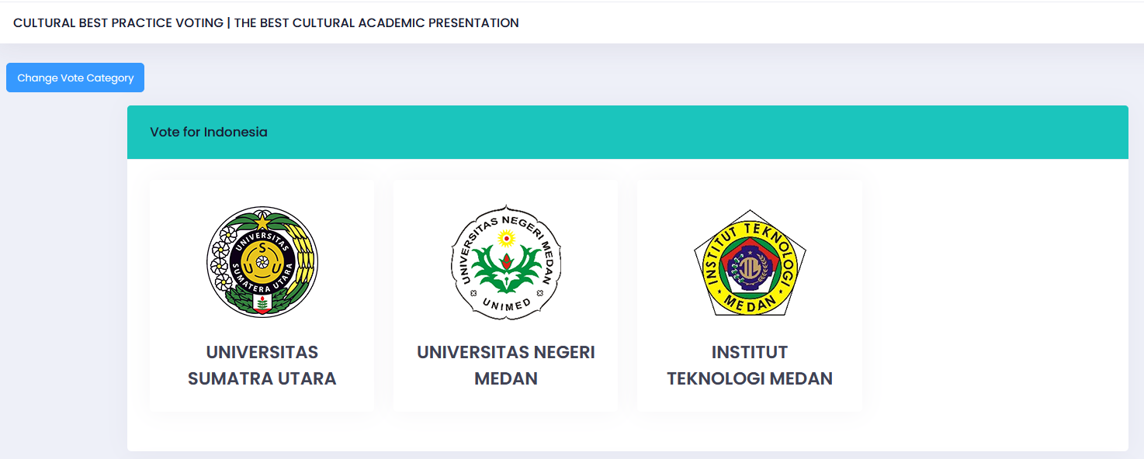
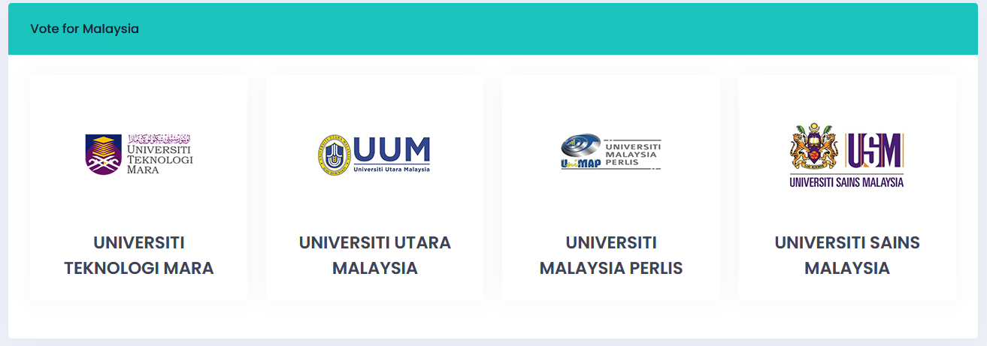
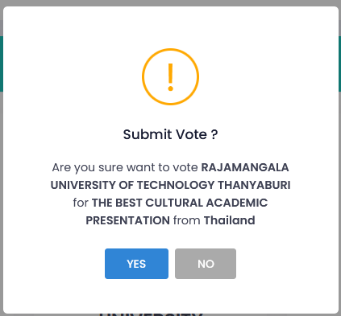
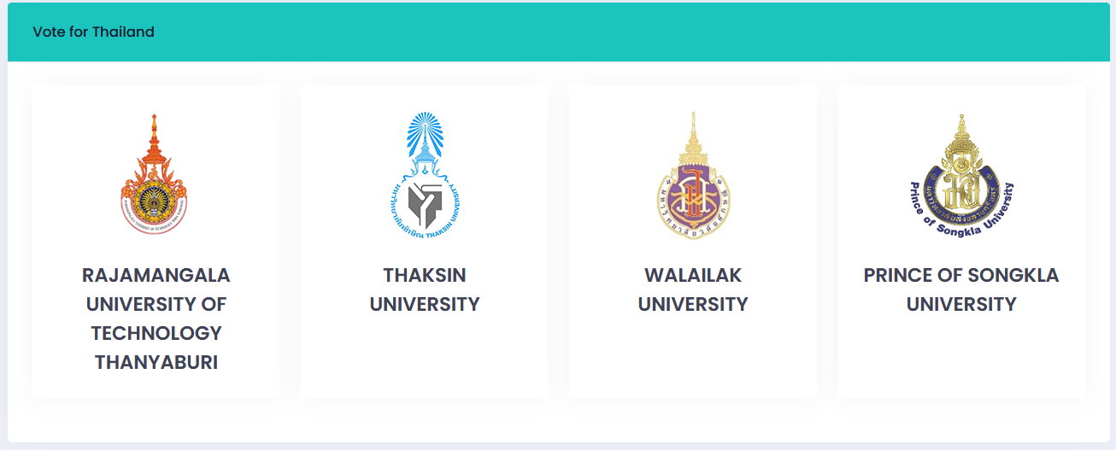
Klik this for change vote category (back button)
The university can’t vote their own university.
(ex: Universitas Syiah Kuala)
Vote and klik 1 university for each country, then comfirm the choice

Slide 18
This notification will be issued when the voting session has ended

Slide 19
THANK YOU

